Slide 1
The Dynamical Resource Theory of Informational Non-Equilibrium
Benjamin Stratton, Chung-Yun Hsieh, Paul Skrzypczyk

Slide 2
The Dynamical Resource Theory of Informational Non-Equilibrium Purity
Benjamin Stratton, Chung-Yun Hsieh, Paul Skrzypczyk

Slide 3
Results Overview
The dynamical resource theory of purity is a framework with which the ability of (a subset of) quantum channels to preserve the purity of states can be compared and quantified for all states in the state space.
The dynamical resource theory of purity is a framework with which the ability of (a subset of) quantum channels to preserve the purity of states can be compared and quantified for all states in the state space.
The dynamical resource theory of purity is a framework with which the ability of (a subset of) quantum channels to preserve the purity of states can be compared and quantified for all states in the state space.
The dynamical resource theory of purity is a framework with which the ability of (a subset of) quantum channels to preserve the purity of states can be compared and quantified for all states in the state space.

Slide 4
Overview
Introduction to Quantum Resource Theories
What is a resource?
Resource Theory Structure
Resource Preservability Theories
Our Framework
Qubit Channels
d dimensional Channels

Slide 5
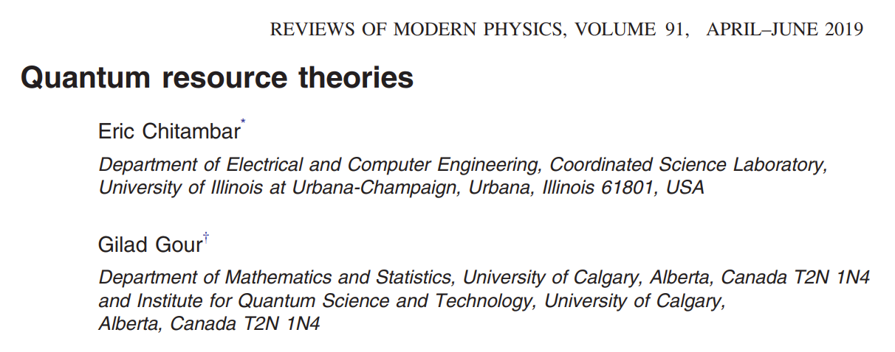
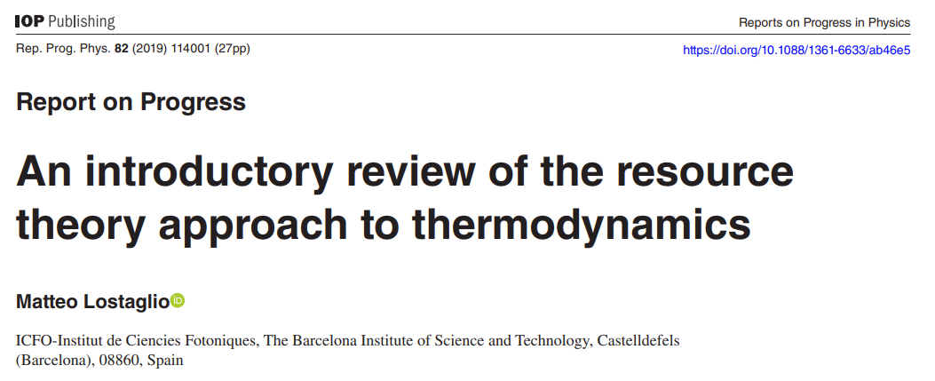
Introduction to Quantum Resource Theories

Slide 6




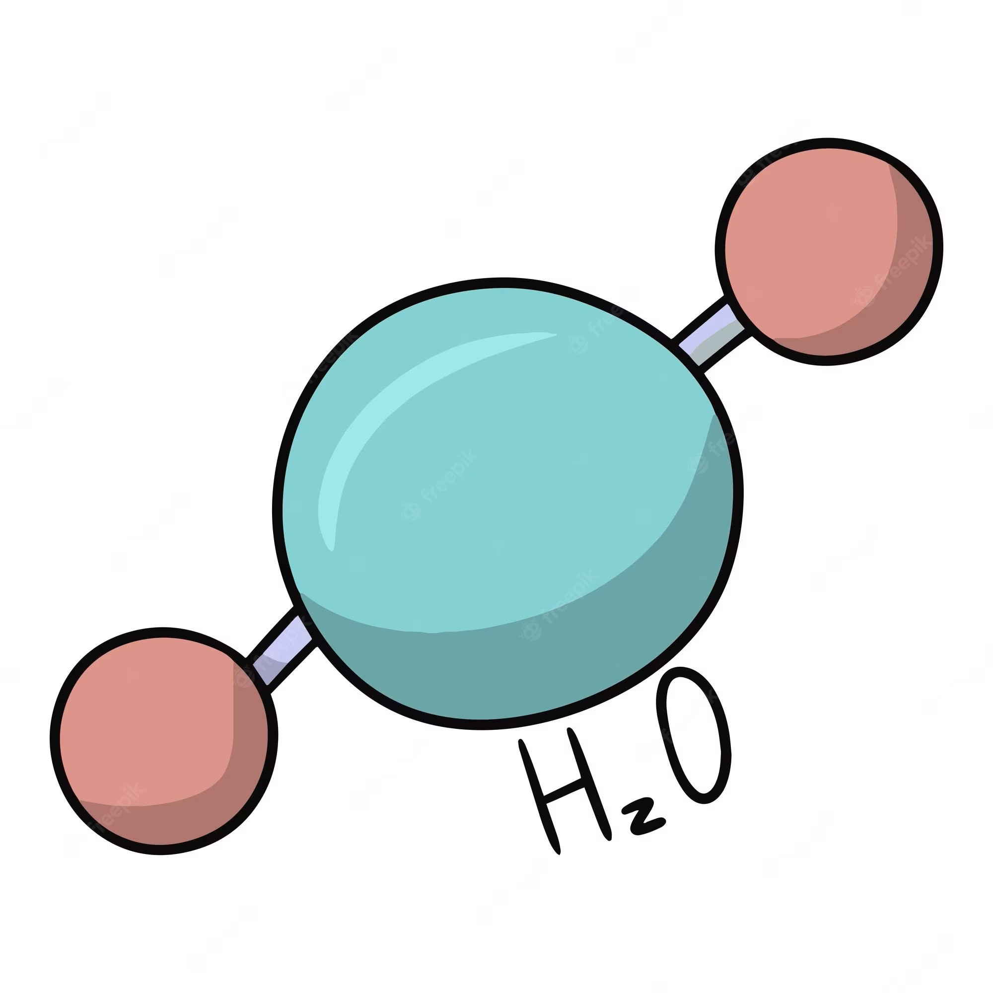

What is a Resource?
Our Agent
Time
Nothing is a resource for an all powerful agent
Notes:
Initially define a resource as something useful or valuable
An all powerful agent can have any amount of anything of do anything

Slide 7
What is a Resource?
Physical Constraints: The Laws of Physics
Therefore have limited access to:
Finite speed of light
Time
Energy Conservation
Quantum Mechanics
Value arises from limitation
And they are consumed to perform a useful task
Notes:
When considering these constraints things become limited
It is limited access to them that gives them value
If you could have an infinte amount of something, it has not value.

Slide 8

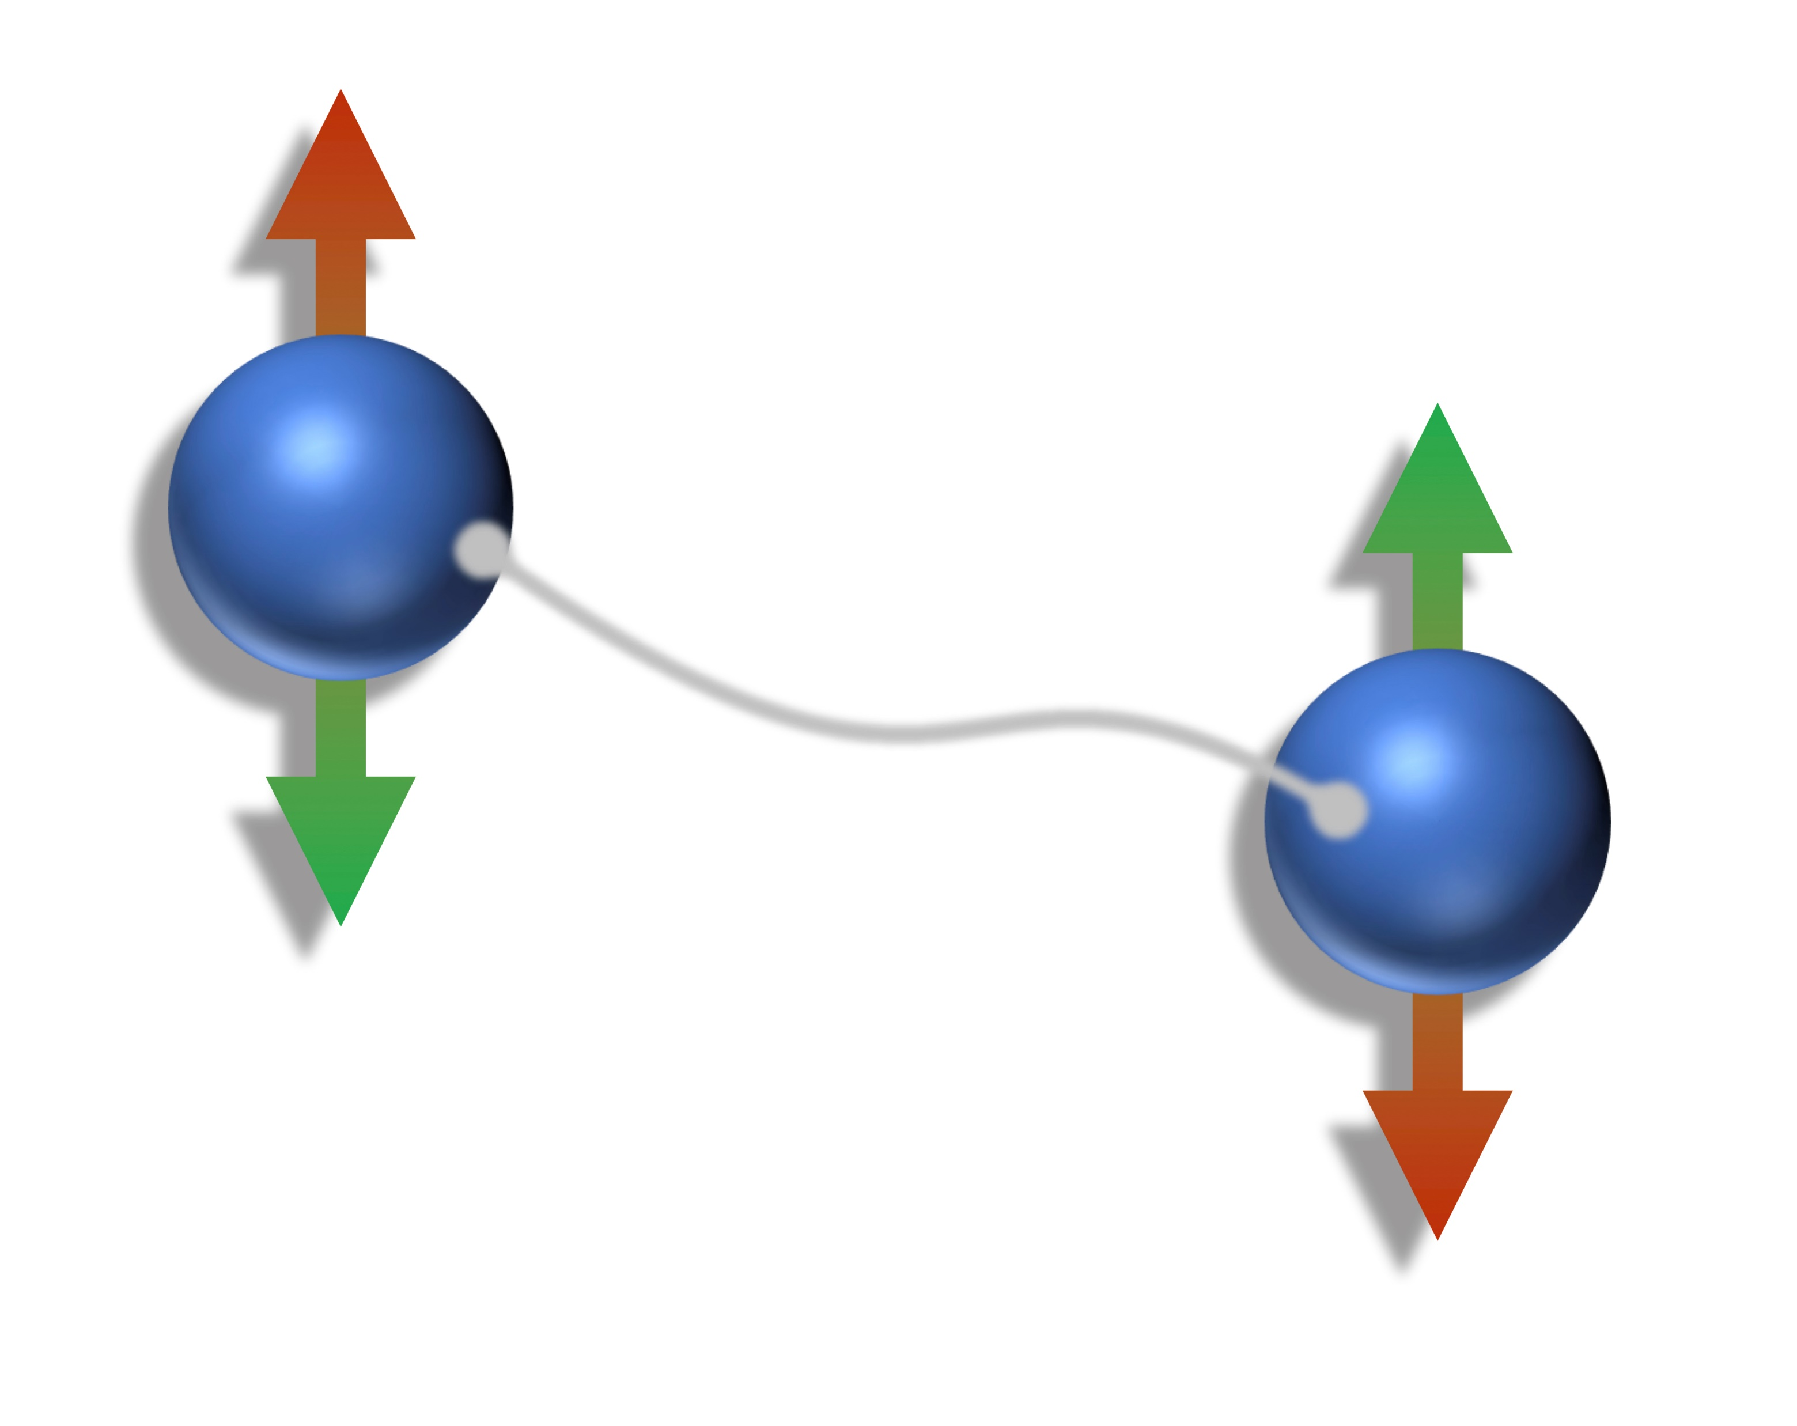
Entanglement
Physical Constraints:
Local Operations
, Classical Communication
Entanglement can:
Only decrease under the physical constraints
Be used to overcome the physical constraints
Teleportation
Alice
Bob
Entanglement is a resource
Within these physical constraints
Notes:
Cannot generate any entanglement through LOCC
LOCC is resource non-generating
Teleportation is the simulation of a noiseless quantum channel sending one qubit from Alice to bob

Slide 9
What is a Resource?
A resource is anything that allows our agent to overcome the physical constraints of the system

Slide 10

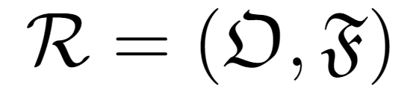

Resource Theories Structure
Allowed operations:
Resource non-increasing maps of objects to objects
Free Objects:
Objects that contain no resource.
Entanglement Example:
Can use this framework to compare the resource content of objects
= LOCC
= Separable States

Slide 11
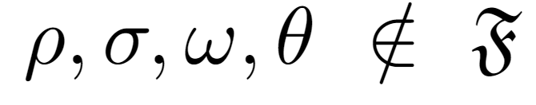
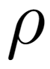
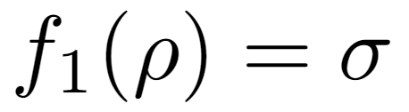

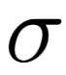

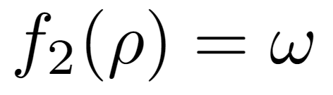
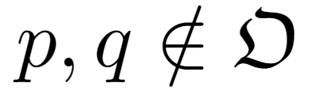
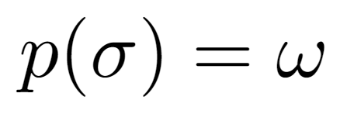
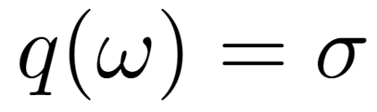

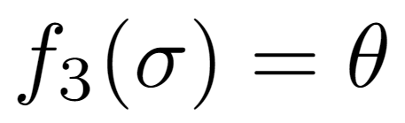
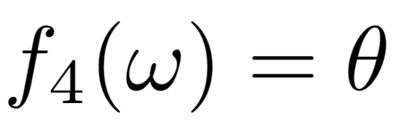
Ordering of Objects
What can we conclude?
Decreasing Resource
Decreasing Resource
What can we not conclude?

Slide 12

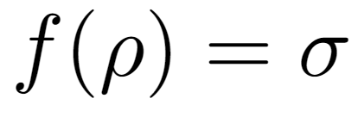
Resource Theory Characterisation
Given two objects and , does there exist an such that
A comparison of the objects resource content can then be made
Overall: A resource theory is the study of limitations imposed by some set of physical constraints
Also consider:
Resource monotones
Simulation of useful channels
Operation interpretations
Catalysis
Resource distillation

Slide 13
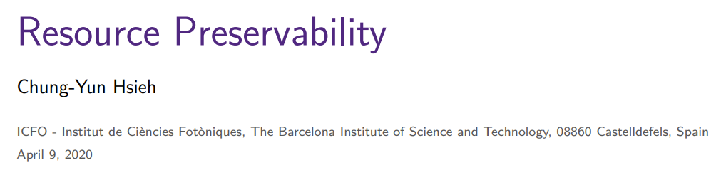
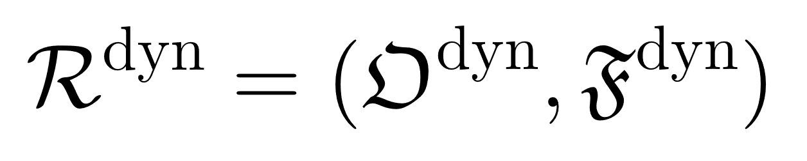
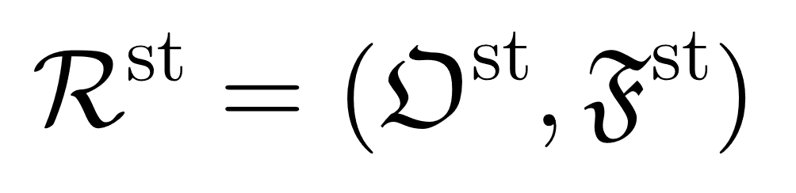
Our Aim
Build and characterise a dynamical resource theory
This will compare the abilities of quantum channels to provide some useful advantage (given a set of constraints)
Specifically, want a resource preservability theory.
Dynamic Resource Theories:
Static Resource Theories:
Set of Super Channels
Set of Quantum Channels
Set of Quantum States
Set of Quantum Channels
[1] Resource Preservability, Chung-Yun Hsieh, 2020

Slide 14


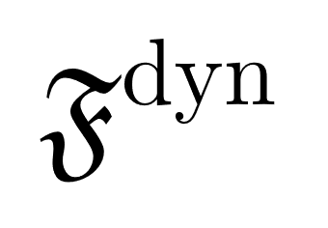
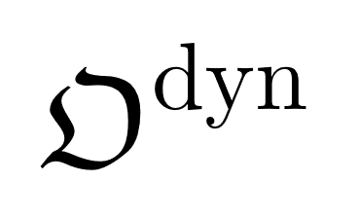
Resource Preservability
A resource preservability theory is a dynamical resource theory
Each static resource theory induces a resource preservability theory
Use a dynamical resource theory to study the maintenance of a resource in a static resource theory.
Resource Preservability Theory
Static Resource Theory
Set of all super channels
Set of all states
Set of all channels

Slide 15

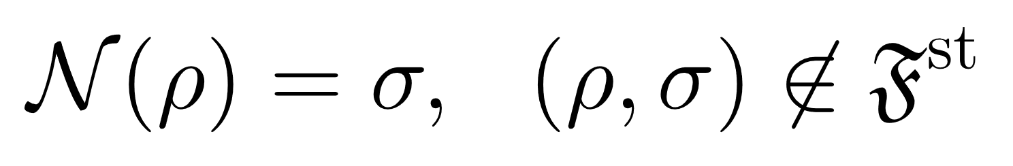

Resourceful Channels
Allowed Operation Exists
between two states
Both states are resourceful
Set of all states

Slide 16
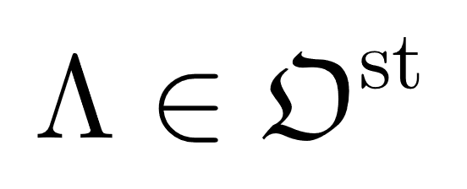
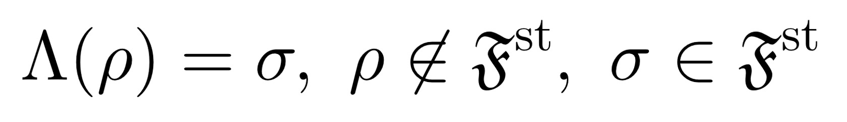
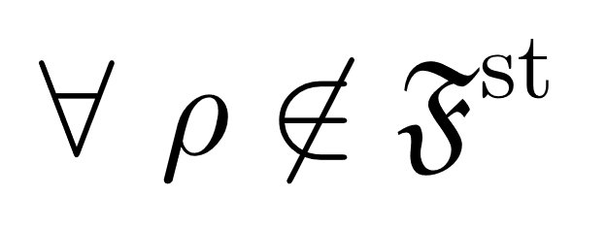
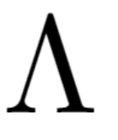
Resourceless Channels
Resourceful State
Resourceless State
Channel in are state preparation channels of states in
Set of all states
Resourceless Channels maintain no resource for all input states

Slide 17

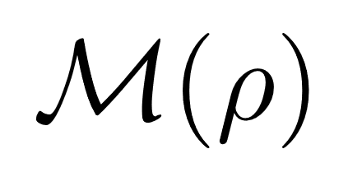
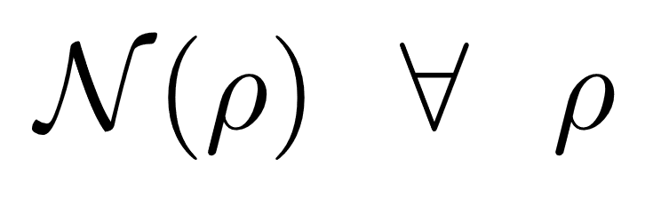
Allowed Operations:
Super Channels
Linear,
Completely positive preserving,
Map: quantum channels quantum channels
Allowed operations take channels in to channels in
Dynamic resource non-increasing
If
The static resource content of a state is less than or equal to the static resource content of .

Slide 18
Resource Preservability - Summary
A resource preservability theory is a dynamical resource theory
Each static resource theory induces a resource preservability theory
Use a dynamical resource theory to study the maintenance of a resource in a static resource theory
A resource preservability theory applies structure to the set of allowed operations of a static resource theory based on the ability of the allowed operations to maintain the static resource.
Preservability
Physical Constraints
Static RT
Limitations

Slide 19
Our Framework

Slide 20
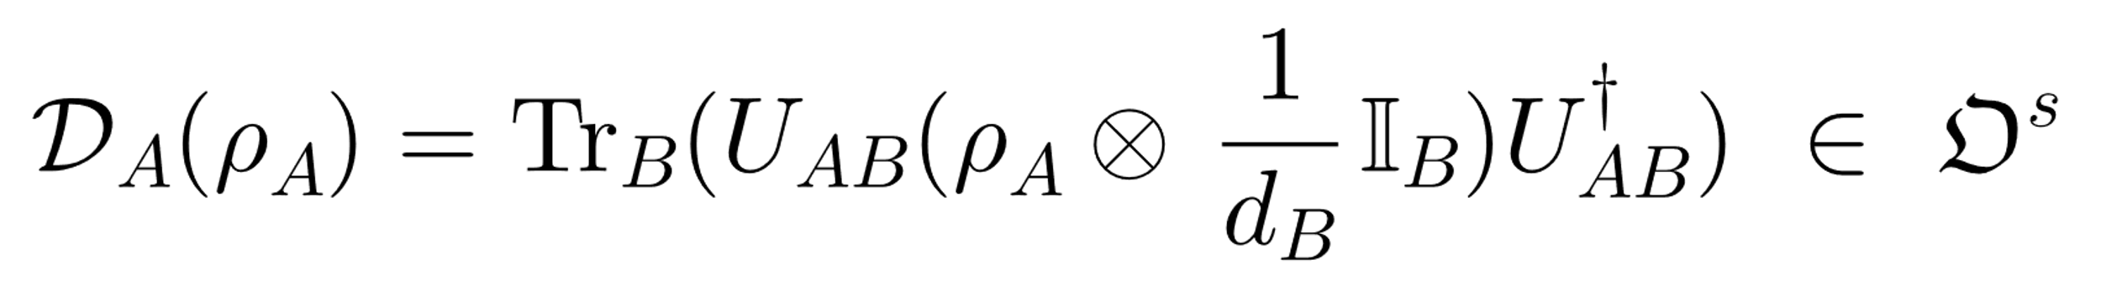
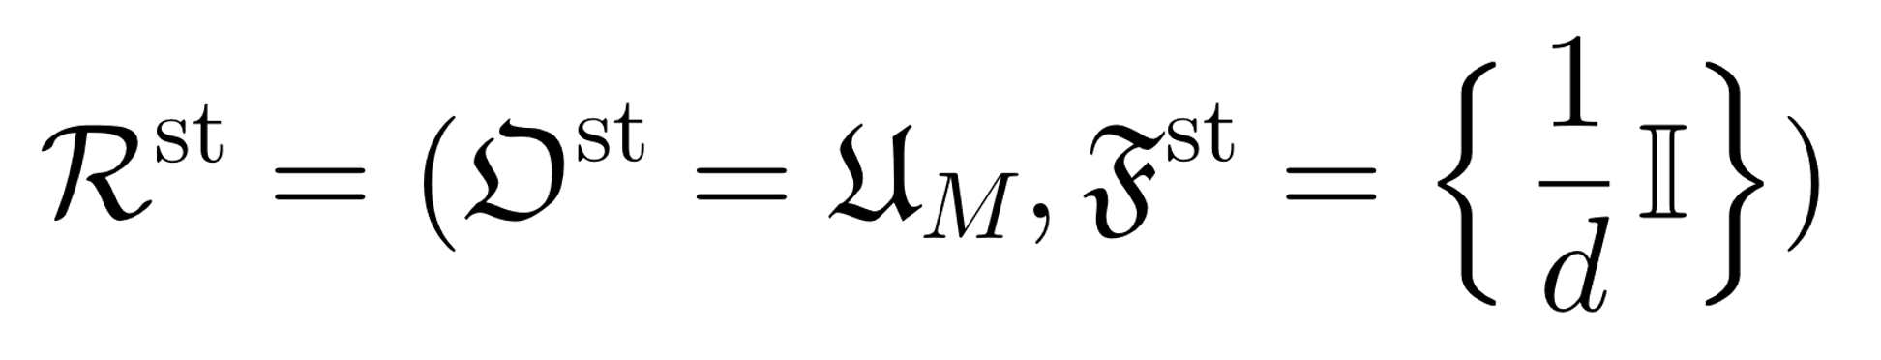
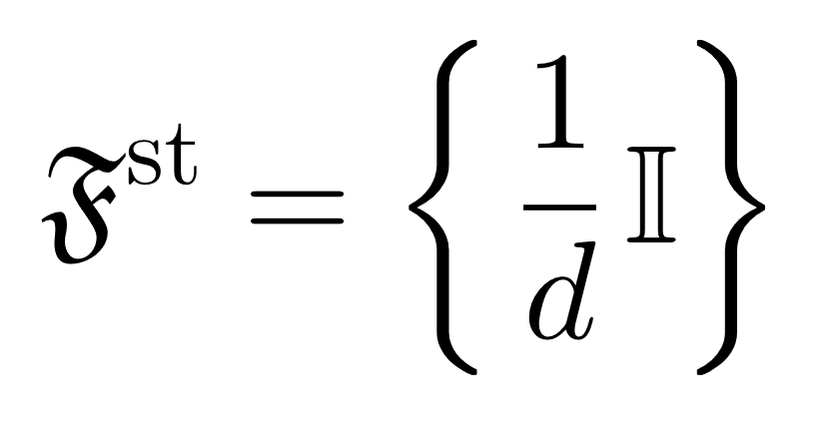
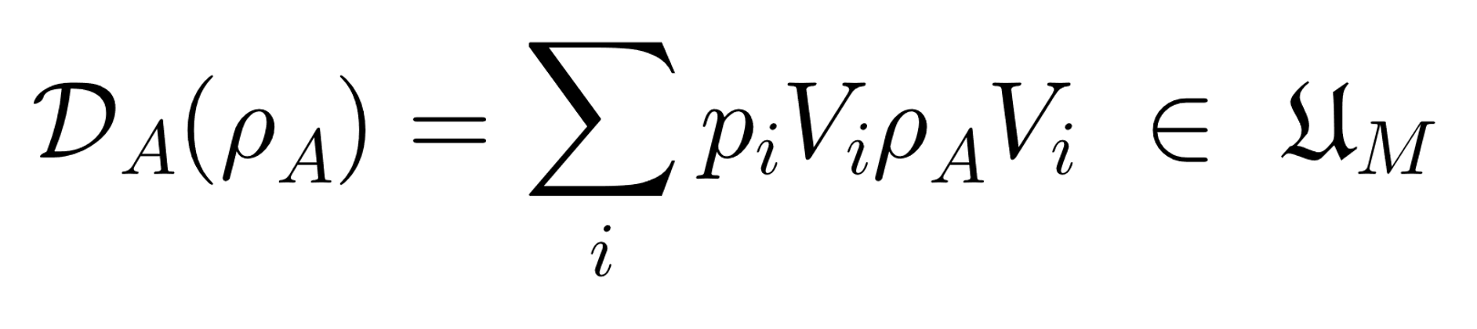
Purity – The Static Resource Theory
The agent can:
Implement any unitary
Prepare any system in the maximally mixed state
Take the partial trace over any subsystem
Allowed Operations:
Free States:
Notes:
Set of noisy operations
Purity is a resource as any non-pure state allows the simulation of a channel outside of the set of noisy operations
Noisy operations are unital operations. Noisy operations are mixed unitary if equal input and output dimension.

Slide 21
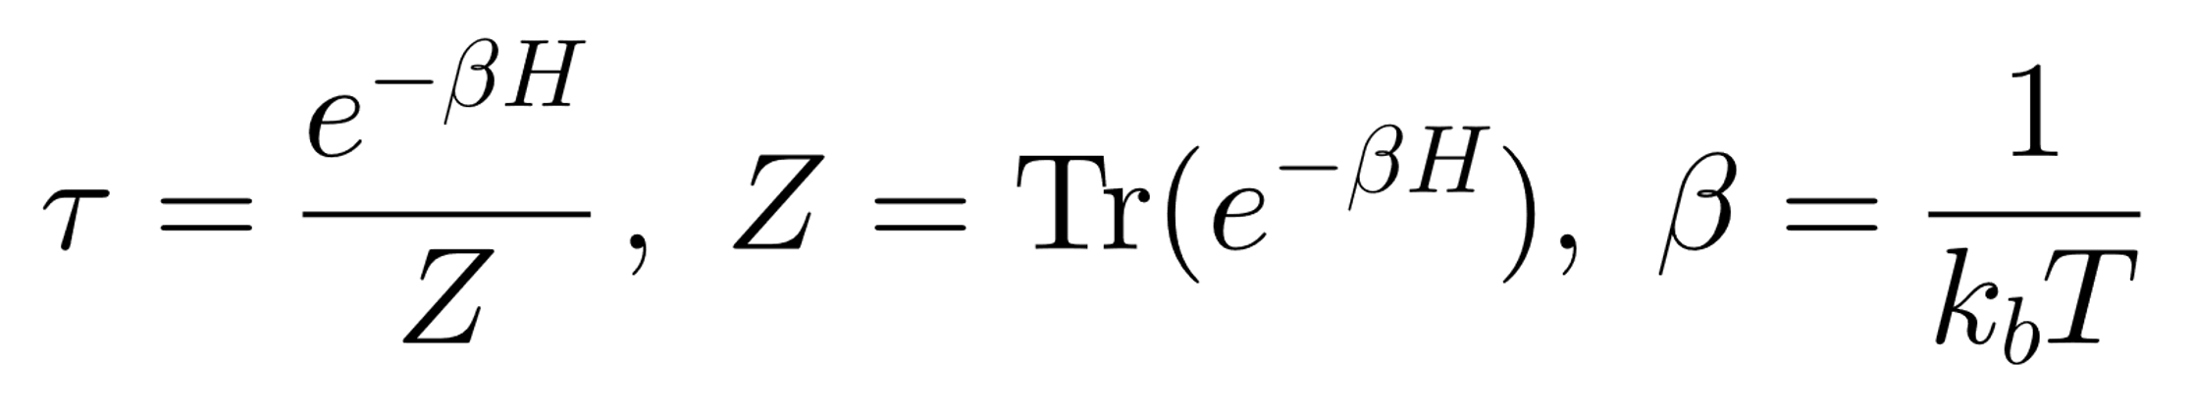
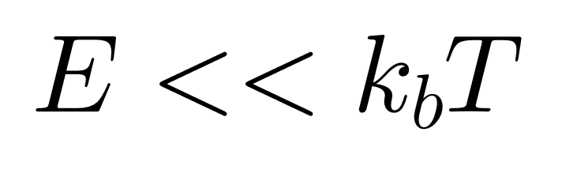
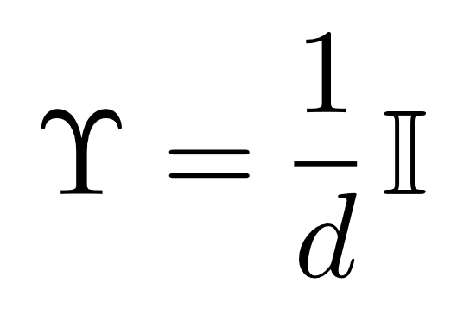
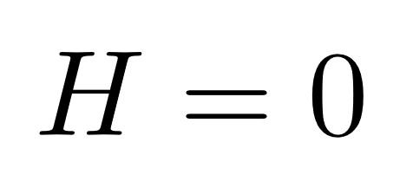
Purity – The Static Resource Theory
Motivation:
Physically and mathematically simple
A special case of the resource theory of thermodynamics
Isolates informational contribution to thermodynamic transformations
Also called the “resource theory of informational non-equilibrium” → Hence the original name
Hopefully can build a resource theory of athermality preserving channels from purity preservability
or
Notes:
Set of thermal operations becomes the set of noisy operations
Purity not same as non-equilibrium unless state space of a fixed size is used.

Slide 22
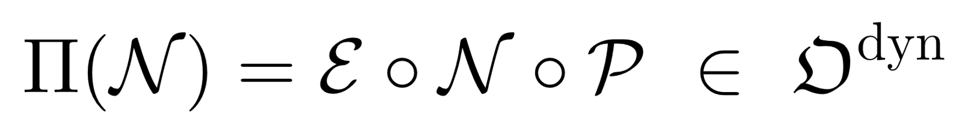
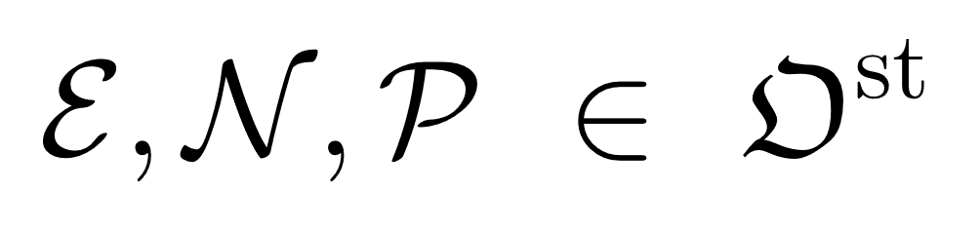
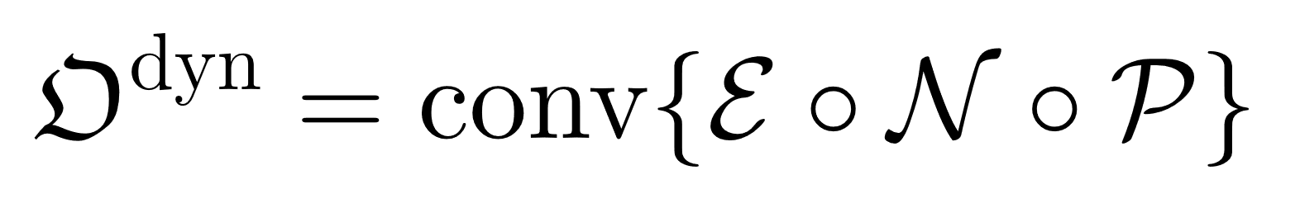
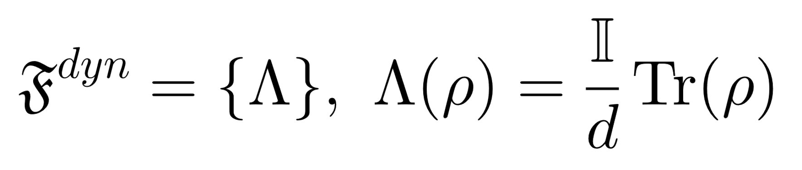
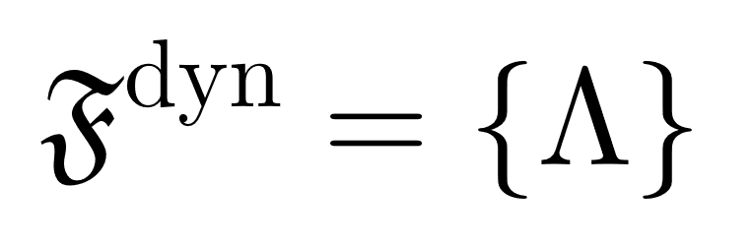
Purity Preservability
Post-processing channel
Pre-processing channel
Allowed Super Channels:
State preparation channel of states in
Free Channels:
Notes:
If a free operation exists then a channel is worst at preserving the resource in all possible input states
Add a side at the end explaining the origin of these superchannels

Slide 23
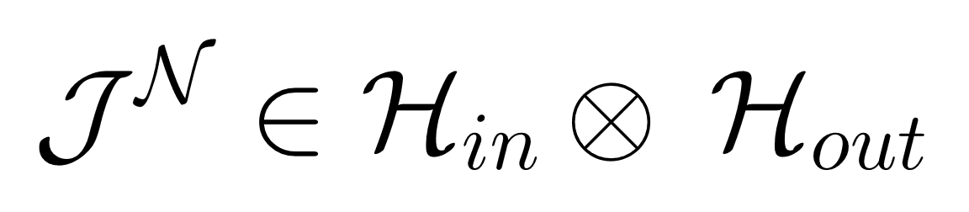

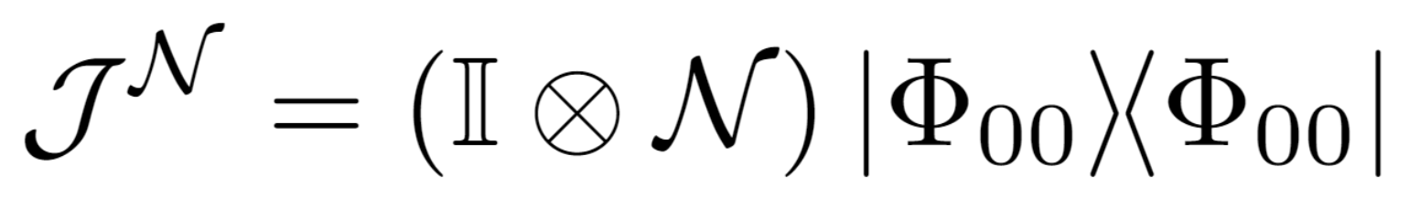
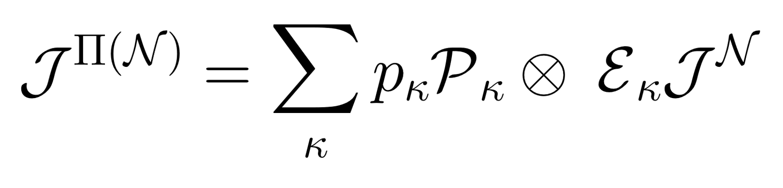
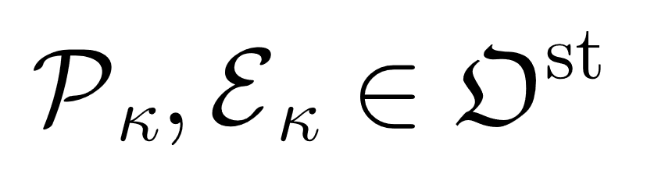
The Choi-Jamiołkowski isomorphism
Allowed Operations in Choi-state formalism:
Any full Schmidt rank state – Max entangled state
Probability vector
Pre-processing channel
Post-processing channel
Notes:
Can now talk about channels without reference to the input state, more compact then Krauss operators

Slide 24
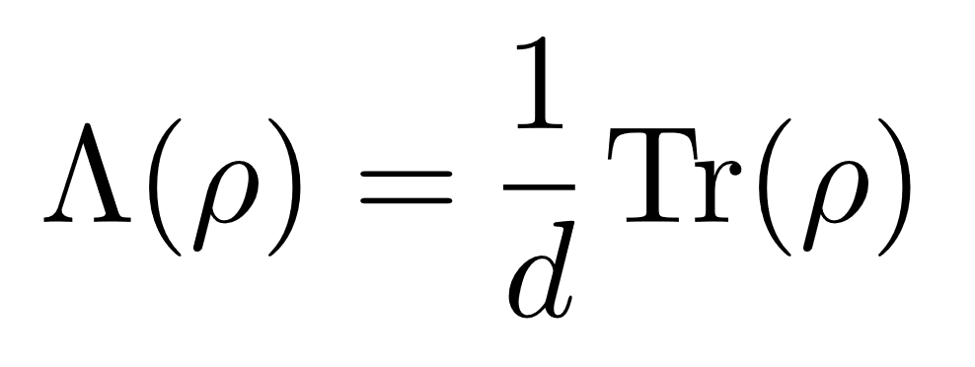
Framework Summary
Purity - Static Resource Theory
Purity Preservability - Static Resource Theory
Notes:
Got to here replacing stuff

Slide 25
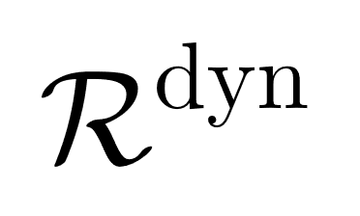
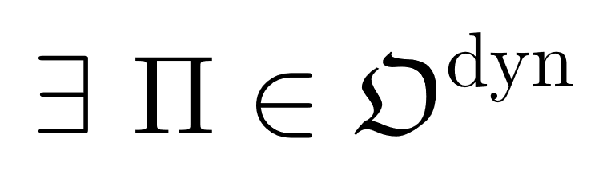


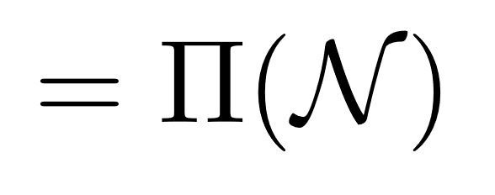
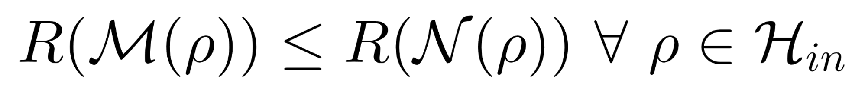




Characterisation
If so, has less dynamic resource than
Ability of to preserves purity is less than or equal to the ability of to preserve purity
- Purity Measure
The states output from will be closer to then the states output from for all input states
can be no more pure than for all input states
Notes:
Less dynamical resource means that M preserves the static resource less than N presevres the static resource
Given an input state rho, the output M(rho) is no more pure than N(rho)

Slide 26
Qubit Channels
is the set of qubit mixed unitary channels

Slide 27

Qubit Channels Characterisation
A convex combination of local permutation matrices

Slide 28






Qubit Channels Characterisation
If and only if
Notes:
This means we can answer the question of if there exists an allowed operation using a simple convex optimisation problem.

Slide 29


Geometric Picture
Due to normalisation:

Slide 30






Qubit Noisy Operation
Convex Hull
Free Channel
Unitary Channels
Notes:
Each point in this continuous R^3 space represents a qubit noisy operation
The outer points are the unitary channels, each is the choi-state of a Pauli operator (Weyl covariant operator).

Slide 31




Qubit Noisy Operation
If
If
Notes:
Each point in this continuous R^3 space represents a qubit noisy operation
The outer points are the unitary channels, each is the choi-state of a Pauli operator (Weyl covariant operator).

Slide 32
From this geometric picture:
A set of 4 inequalities that are a complete set of monotones for can be found.
A set of 4 states that can be used in a state discriminations task that fully characterises the ordering set by can be found.
Additionally (not from geometric picture):
The Holovo capacity was found to be a montone of .
Notes:
Say there are usually infinite monotones but here there are only 4.

Slide 33


Qubit Channels Examples

Slide 34





Slide 35




Notes:
Put in geometric picture underthis

Slide 36




Slide 37




Notes:
Put in geometric picture underthis

Slide 38



Notes:
Put in geometric picture underthis

Slide 39


Dimensional Channels
is the set of Weyl covariant channels

Slide 40



Dimensional Channels

Slide 41

For Dimensional Channels:
A set of inequalities that are a complete set of monotones for can be found.
A set of states that can be used in a state discriminations task that fully characterises the ordering set by can be found.
The Holovo capacity was found to be a montone of .

Slide 42

Future Directions
Characterise for arbitrary dimensional noisy operations.
Currently been done for qubits and Weyl covariant channels only.
Consider and expand to the resource theory of thermodynamics

Slide 43
Key Take Aways
Resource Preservability theories apply structure to the set of allowed operations of a static resource theory.
We characterised the pre-order set by such a resource preservability theory on the allowed operations of the static resource theory of purity.
For qubit and dimensional Weyl covariant channels
Our framework allows the quantification and comparison of noisy operations ability to preserve purity.

Slide 44





Superchannels
If
If
‘comb’ structure indicates the possibility of correlations between pre and post processing
https://doi.org/10.1038/s41467-021-24699-0

Slide 45

Allowed Super Channels
Notes:
No comb structure in this diagram but result holds if we include the correlations.

Slide 46

The Holovo Capacity
Lower bound on the classical capacity of a channel
Informally, this is the amount of classical information that can be transmitted using the channel.
This result shows that the ability of a channel to maintain purity directly impacts ability of that channel to communicate classical bits – as expected.

Slide 47




Qubit Channels Proof Sketch
Used the following lemma:
Given all unitary channels are in , an allowed operation always exists that can diagonalise the Choi-state.

Slide 48








Qubit Channels Proof Sketch
[ ]
=
= Mixed unitary channels
Is the matrix with elements
=

Slide 49

Qubit Channels Proof Sketch
Is the matrix with elements
Used the following lemma:
Then need to prove the reverse…

Slide 50


Physical Intuition:
Any pure state fulfils this for this example.

Slide 51





What is a Resource?
Physical Constraints: The Laws of Physics, Human
(a) On Land
(b) Under the Sea
Oxygen has value within the defined physical constraints of (b)
Amount of air can only decrease under defined constraints of (b)
Notes:
Can have as much oxygen as you want on land, it is not limited

Slide 52
The Dynamical Resource Theory of Informational Non-Equilibrium Preservability
Benjamin Stratton, Chung-Yun Hsieh, Paul Skrzypczyk

Slide 53
The Dynamical Resource Theory of Informational Non-Equilibrium Purity Preservability
Benjamin Stratton, Chung-Yun Hsieh, Paul Skrzypczyk

Slide 54
Results Overview
The dynamical resource theory of purity is a framework with which the ability of (a subset of) quantum channels to preserve the purity of states can be compared and quantified for all states in the state space.
The dynamical resource theory of purity is a framework with which the ability of (a subset of) quantum channels to preserve the purity of states can be compared and quantified for all states in the state space.
The dynamical resource theory of purity is a framework with which the ability of (a subset of) quantum channels to preserve the purity of states can be compared and quantified for all states in the state space.
The dynamical resource theory of purity is a framework with which the ability of (a subset of) quantum channels to preserve the purity of states can be compared and quantified for all states in the state space.

Slide 55
Ordering In Resource Theories
What can we conclude?
Decreasing Resource
Decreasing Resource
What can we not conclude?

Slide 56
Qubit Channels Characterisation
A convex combination of local permutation matrices

